Slide 1
Building Structures from Classifiers for Passage Reranking
Date: 2014/02/25
Author: Aliaksei Severyn, Massimo
Nicosia, Aleessandro Moschitti
Source: CIKM’13
Advisor: Jia-ling Koh
Speaker: Chen-Yu Huang

Slide 2
Outline
Introduction
Learning to rank with kernels
Structural models of Q/A pairs
Feature vector representation
Experiment
Conclusion

Slide 3
Introduction
What is Mark Twain‘s real name?
Search engine
Roll over, Mark Twain, because Mark McGwire is on the scene.
Samuel Langhorne Clemens, better known as Mark Twain.
Mark Twain couldn't have put it any better.
Roll over, Mark Twain, because Mark McGwire is on the scene.
Samuel Langhorne Clemens, better known as Mark Twain.
Mark Twain couldn't have put it any better.

Slide 4
Introduction
Automated question answering(QA) is a complex task that often requires manual definition of rules and syntactic patterns to detect the relations between a question and its candidate answers
Compute a textual similarity
Machine learning
Build a answer passage reranking model
encodes powerful syntactic patterns relating q/a pairs
Automatically extracted and learned the feature not require manual feature engineering

Slide 5
Outline
Introduction
Learning to rank with kernels
Tree kernel
Preference reranking with kernels
Structural models of Q/A pairs
Feature vector representation
Experiment
Conclusion

Slide 6
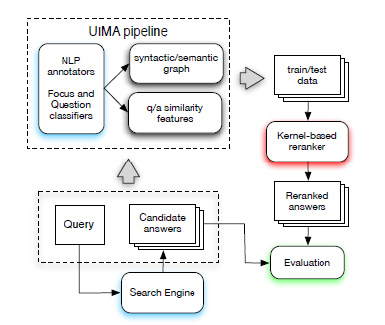
Kernel-based answer passage reranking system

Slide 7
Kernel-based answer passage reranking system
Model q/a pairs as linguistic structure
Automatically extracted and learn powerful syntactic patterns
< , >
What is Mark Twain‘s real name?
Samuel Langhorne Clemens, better known as Mark Twain.

Slide 8
Tree kernels
Syntactic Tree Kernels (M. Collins, 2002)
Partial Tree Kernel (A. Moschitti, 2006)
A function that can be effectively applied to both constituency and dependency parse trees.

Slide 9
Preference reranking with kernels
To enable the use of kernels for learning to rank with SVMs, use preference reranking (T. Joachims, 2002)
A set of q/a pairs {a, b, c, d, e}
a>b , a>c, b>c, c > e …
Preference kernel

Slide 10
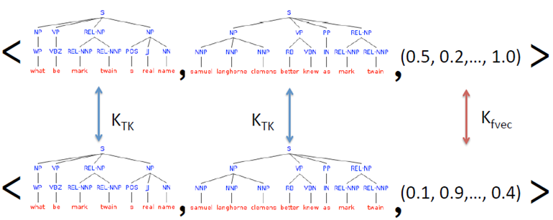
Preference reranking with kernels
q/a pair:a, c
KTK(Qa, Qc) = 1.0, KTK(Aa, Ac) = 0.7, Kfvec(a, c) = 0.3
K(a, c) = 1.0+0.7+0.3 = 2.0

Slide 11
Outline
Introduction
Learning to rank with kernels
Structural models of Q/A pairs
Structural representations
Relational tag using question focus and question category
Feature vector representation
Experiment
Conclusion

Slide 12
Structural representation
Shallow tree structure
This is a essentially a shallow syntactic structure built from part-of-speech tags grouped into chunks
A special REL tag links the related structures

Slide 13
Relational tag using question focus and question category
Use the question category to link the focus word of a question with the name entities extracted form the candidate answer
Six non overlapping classes
abbreviations(ABBR)
Descriptions(DESC)
Entity(ENTY)
Human(HUM)
Location(LOC)
Numeric(NUM)

Slide 14
Relational tag using question focus and question category

Slide 15
Outline
Introduction
Learning to rank with kernels
Structural models of Q/A pairs
Feature vector representation
Experiment
Conclusion

Slide 16
Feature vector representation
The total number of basic feature is 24
N-gram of part-of-speech
NER relatedness
LDA
…

Slide 17
Outline
Introduction
Learning to rank with kernels
Structural models of Q/A pairs
Feature vector representation
Experiment
Conclusion

Slide 18
Experiments---1
Corpora
Train data: TREC QA data 2002 and 2003 years (824 questions)
Test data: TREC 13
Search engines
TREC and Answerbag
50 candidate answers for each questions

Slide 19
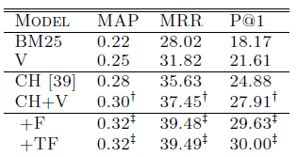
Experiments---1
Baseline
BM25
CH (shallow tree)
V (reranker model)
Approach
F ( semantic linking)
TF ( adding a question category)

Slide 20
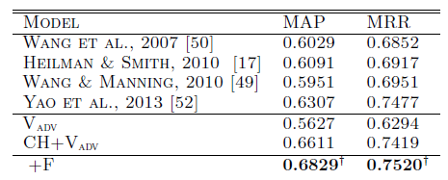
Experiments---2
Corpora
Train data: TREC 8-12
Test data: TREC 13
Advanced feature ( Vadv)
Greedy String Tiling
Resnik similarity
…

Slide 21
Outline
Introduction
Learning to rank with kernels
Structural models of Q/A pairs
Feature vector representation
Experiment
Conclusion

Slide 22
Conclusion
Use of structural kernel technology to induce rich feature spaces form structural sematic representations of question and answer passage pairs.
Provide adaptable question and focus classifiers.
Conceptually simpler than previous system.

Slide 23
MRR( Mean Reciprocal Rank)
mean reciprocal rank
= (1/3 + 1/2 + 1)/3 = 11/18

